Slide 1
Detecting spontaneous symmetry breaking in 1+1 dimensional bosonic models Method: Lightcone Conformal Truncation (LCT) Supervisor: Emanuel katz

Slide 2

OUTLINE
Motivation
Projects
$φ^{4}$ theory (Completed)
$φ^{6}$ theory (Completed)
Variational approach to bosonic LCT (Underway)

Slide 3
INTRODUCTION
Quantum Field Theory: A quantum theoretical framework designed to model fundamental particles and their interactions.
Pros: Relativistic, allows arbitrary production and absorption of particles
Cons: Quantum dynamics difficult to extract, reliance on perturbative or approximate schemes.
Current lines of research (analytical): (generalized) symmetry, conformal symmetry, numerical/analytical bootstrap, integrability, lightcone quantization…
Numerical methods: Lattice field theory, Hamiltonian truncation, Monte Carlo simulations…

Slide 4
Lightcone conf. truncation (LCT)
A numerical method designed to study QFTs nonperturbatively.
Ingredients: Lightcone quantization, Solvable conformal field theory (CFT)
Lightcone quantization simplifies computations when the vacuum structure is fixed. Fails to reproduce dynamics when going over phase transitions.
CFT provides strong calculational tools in 1+1-D for computing observables (radial quantization, OPE etc.)
Advantage over truncation and lattice:
Can build a basis that works in the infinite volume limit directly.
INTRODUCTION

Slide 5
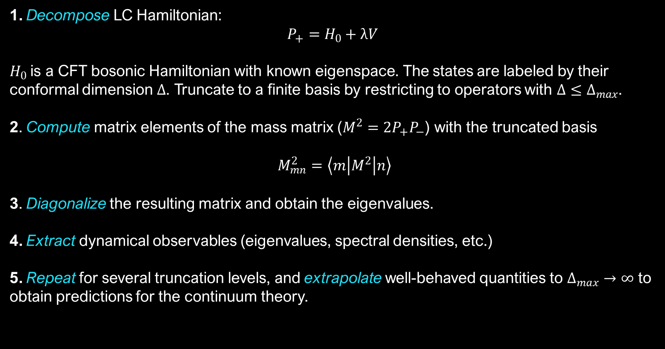
LCT specifics
1. Decompose LC Hamiltonian:
$$P_{+}=H_{0}+λV$$
$H_{0}$is a CFT bosonic Hamiltonian with known eigenspace. The states are labeled by their conformal dimension $Δ$. Truncate to a finite basis by restricting to operators with $Δ≤Δ_{max}$.
2. Compute matrix elements of the mass matrix ($M^{2}=2P_{+}P_{−}$) with the truncated basis
$M_{mn}^{2}=\left\langle m\left|M^{2}\right|n\right\rangle$
3. Diagonalize the resulting matrix and obtain the eigenvalues.
4. Extract dynamical observables (eigenvalues, spectral densities, etc.)
5. Repeat for several truncation levels, and extrapolate well-behaved quantities to $Δ_{max}→∞$ to obtain predictions for the continuum theory.

Slide 6

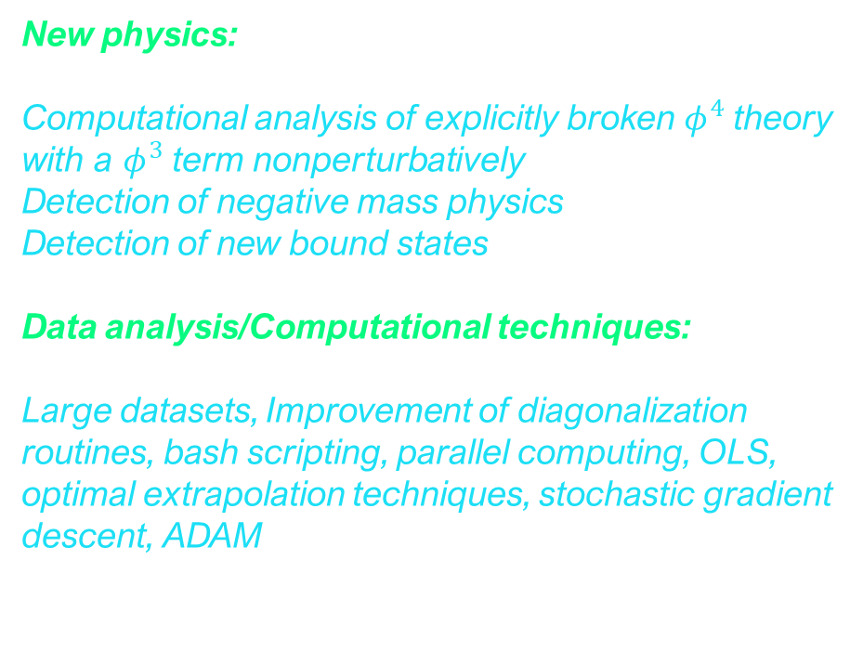

PROJECT I: $φ^{4}$ theory
New physics:
Computational analysis of explicitly broken $φ^{4}$ theory with a $φ^{3}$ term nonperturbatively
Detection of negative mass physics
Detection of new bound states
Data analysis/Computational techniques:
Large datasets, Improvement of diagonalization routines, bash scripting, parallel computing, OLS, optimal extrapolation techniques, stochastic gradient descent, ADAM

Slide 7
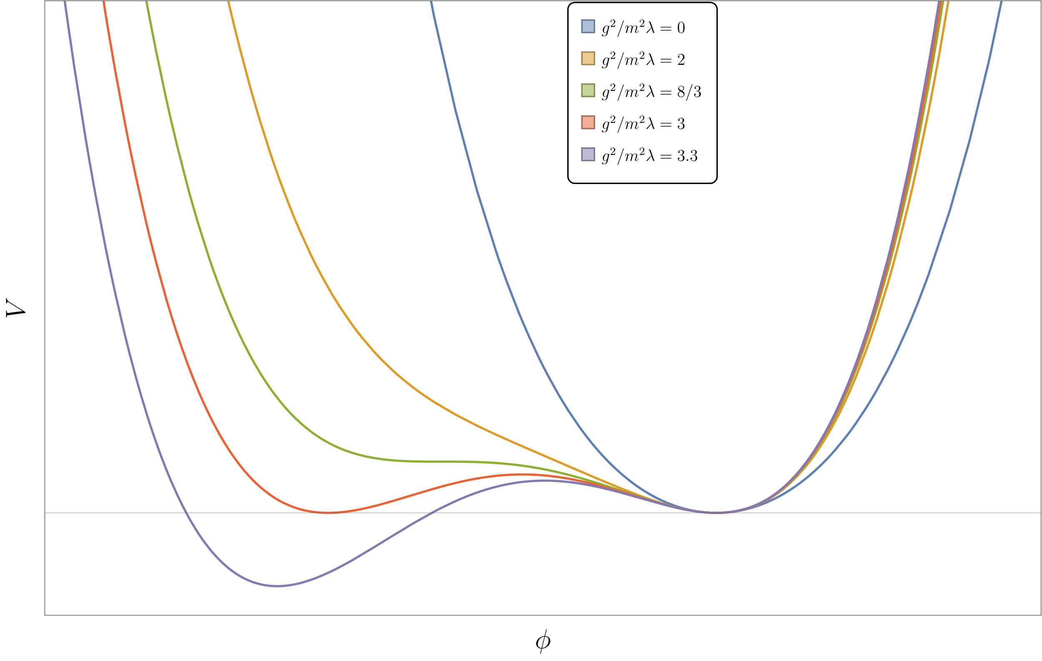
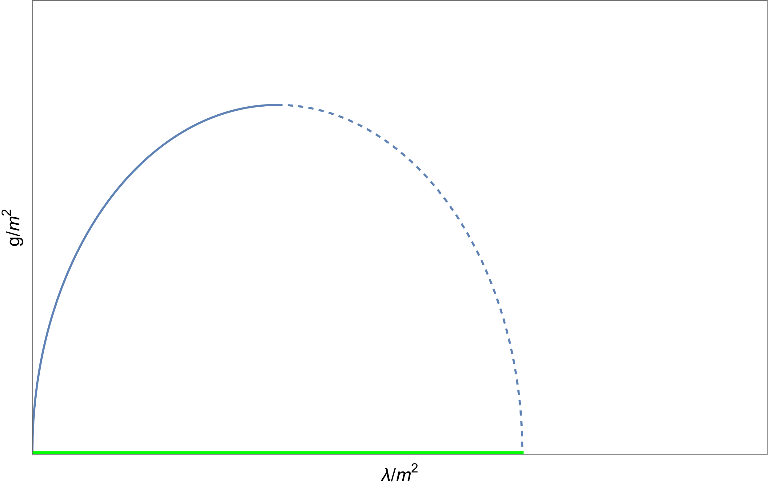
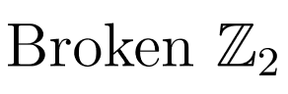
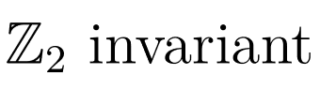

This target Hamiltonian presents with strong and weak spontaneous symmetry breaking (SSB):
$$H=\int{dx_{−}\left(\frac{λ}{4!}φ^{4}−\frac{m_{0}^{2}}{2!}φ^{2}\right)}$$
Special LCT implementation required to quantize around the right vacuum, we break the discrete symmetry explicitly:
$$H_{LC}=\int{dx_{−}\left(\frac{λ}{4!}φ^{4}+\frac{g}{3!}φ^{3}+\frac{m^{2}}{2!}φ^{2}\right)}$$
Lightcone quantization indicates $H$ will appear as the boundary of the broken phase in this model. LCT will not be able to explore past this point, but it can extract observables on the boundary. Weak coupling shape of the transition curve:
$$g≈\sqrt{3λm^{2}}$$
Expected semiclassical $Z_{2}$ breaking pattern for $H_{LC}$
?
Bound state
(Explicitly)
Ising FP
Expected phase transition diagram and other features

Slide 8
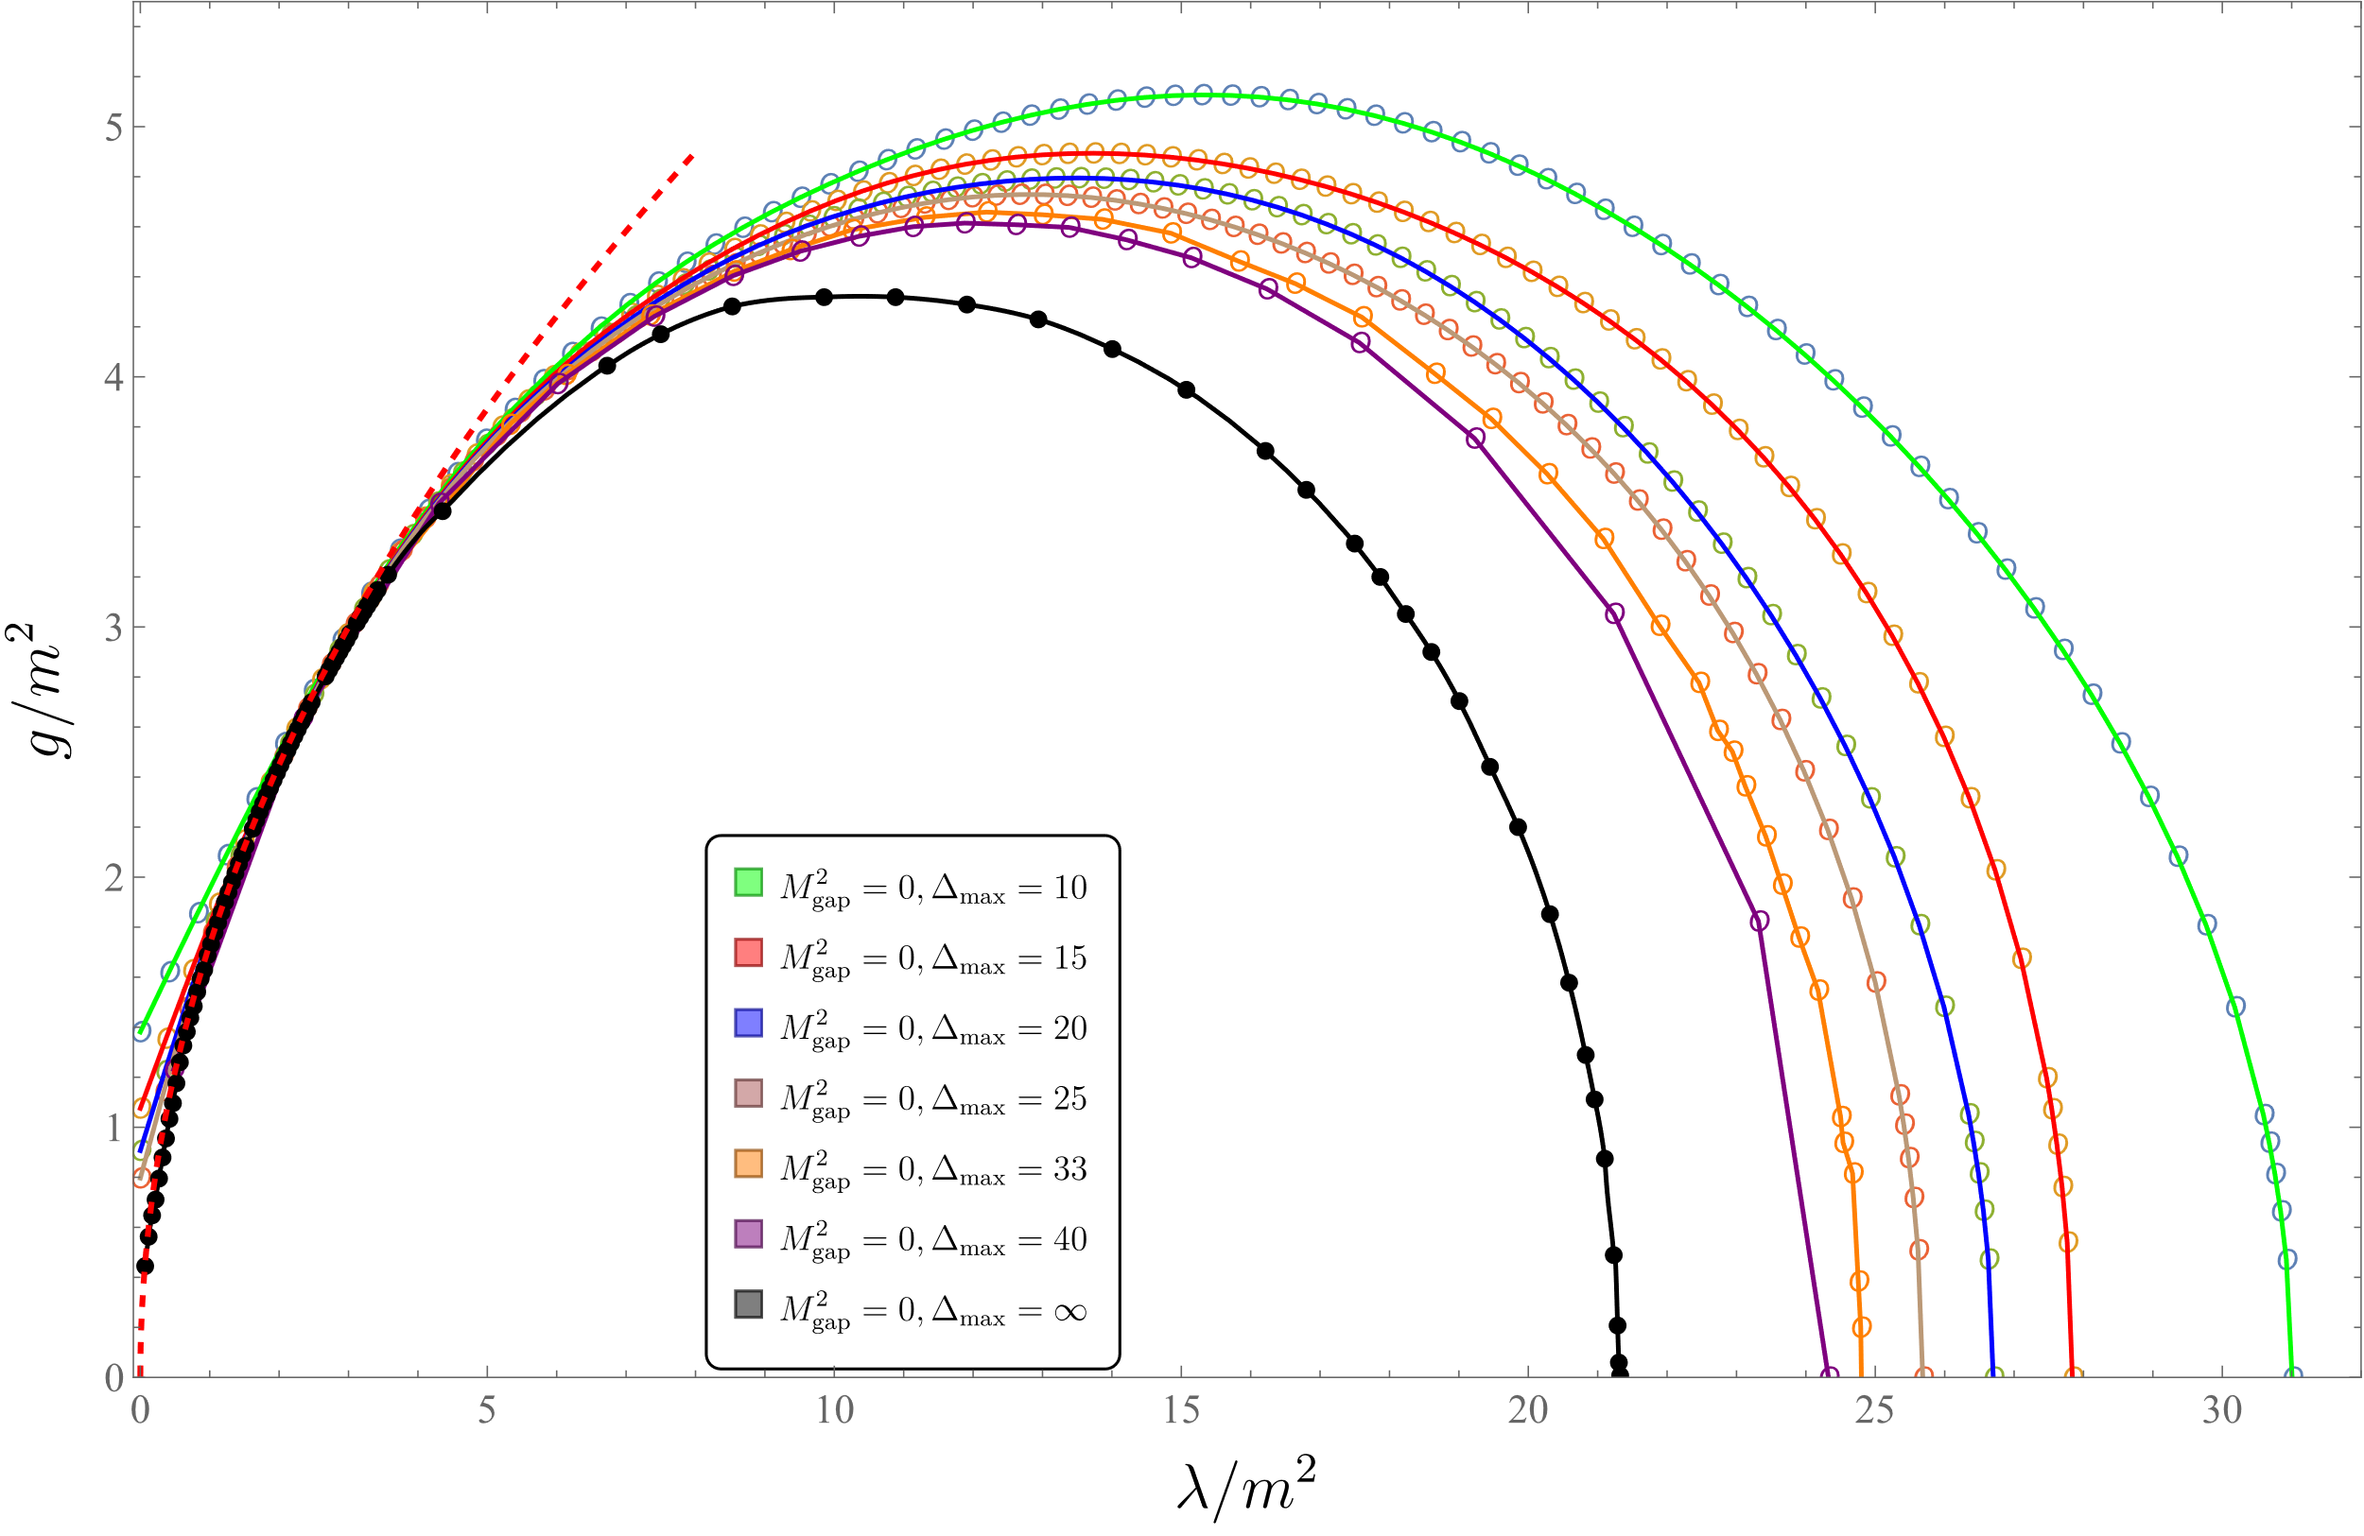
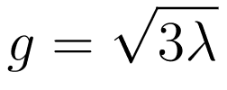
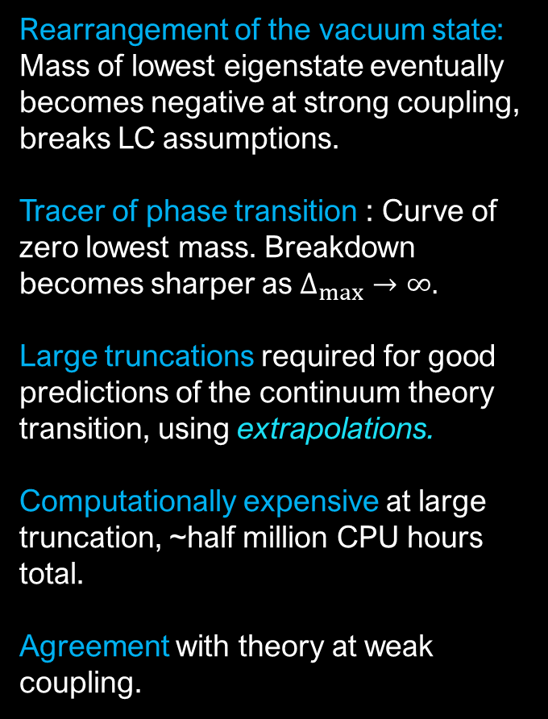
Rearrangement of the vacuum state: Mass of lowest eigenstate eventually becomes negative at strong coupling, breaks LC assumptions.
Tracer of phase transition : Curve of zero lowest mass. Breakdown becomes sharper as $Δ_{max}→∞.$
Large truncations required for good predictions of the continuum theory transition, using extrapolations.
Computationally expensive at large truncation, ~half million CPU hours total.
Agreement with theory at weak coupling.
Phase transition prediction for various truncation levels. Continuum theory in black.

Slide 9
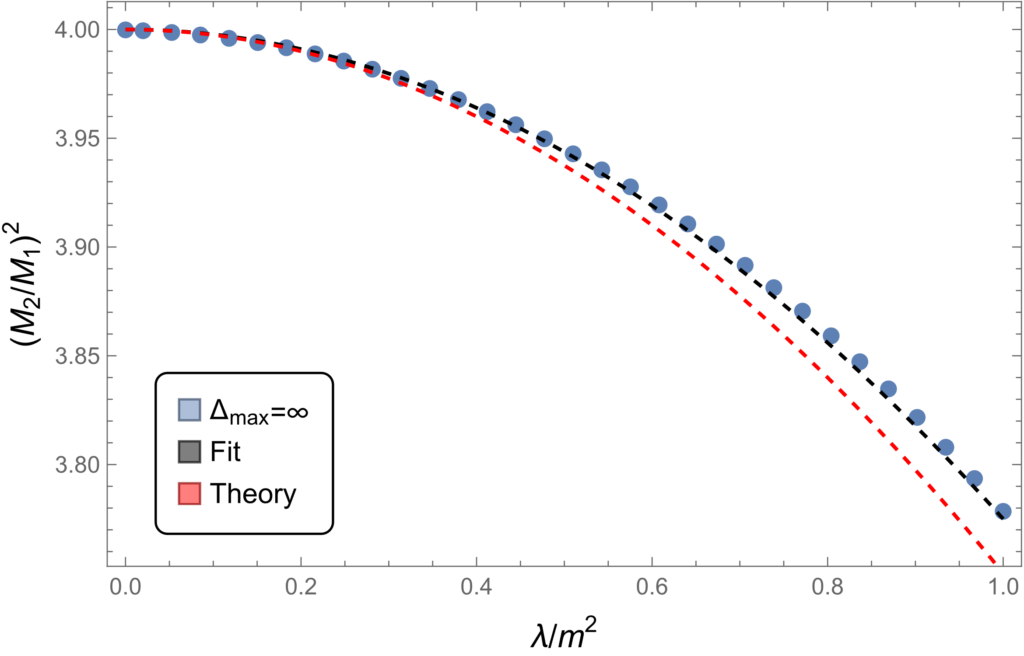
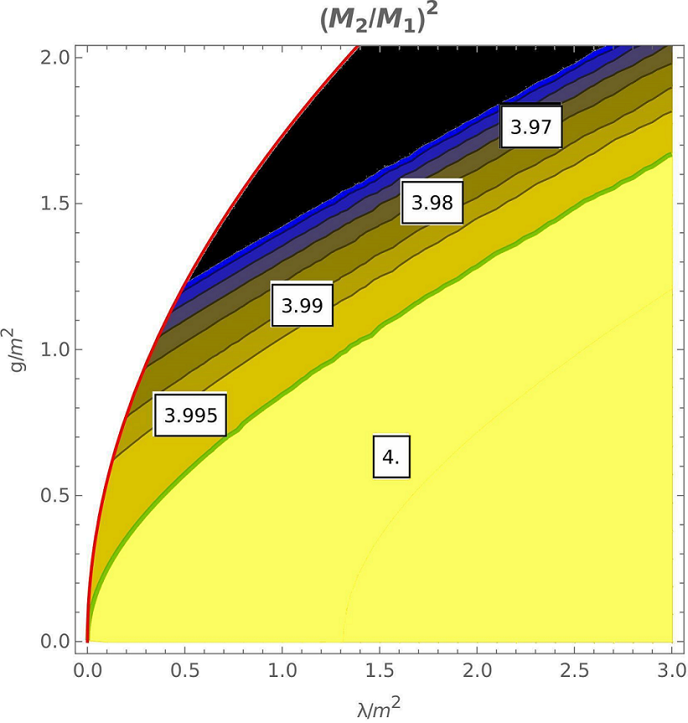
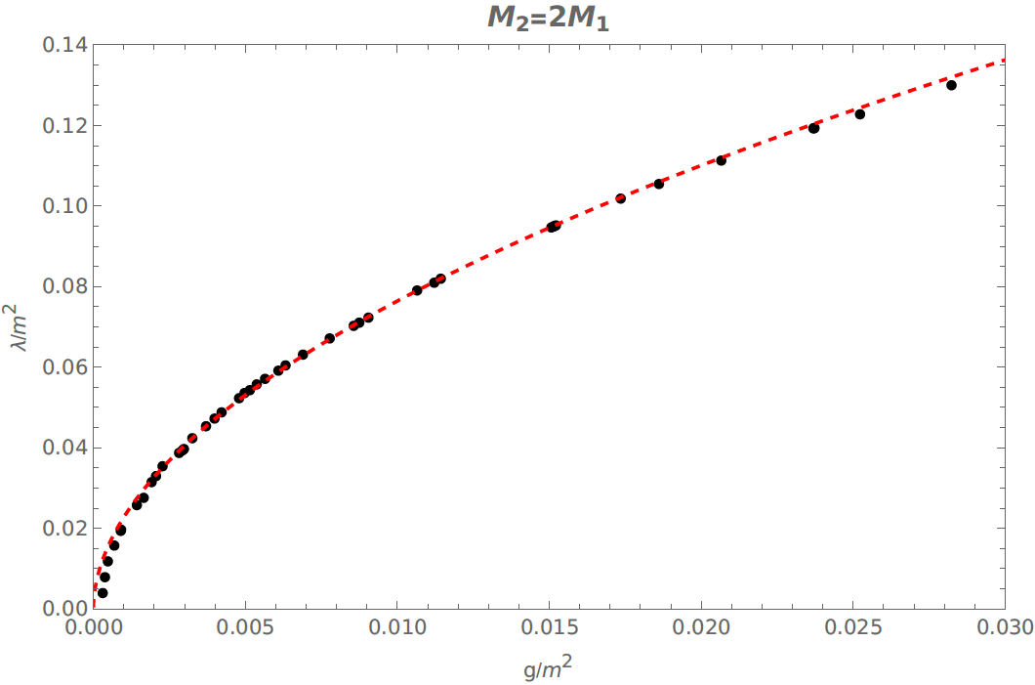
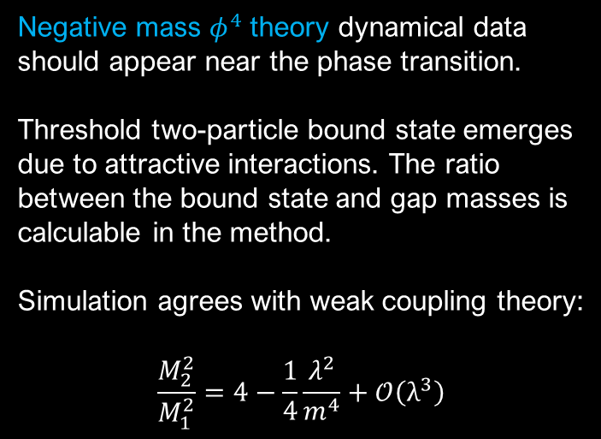

Negative mass $φ^{4}$ theory dynamical data should appear near the phase transition.
Threshold two-particle bound state emerges due to attractive interactions. The ratio between the bound state and gap masses is calculable in the method.
Simulation agrees with weak coupling theory:
$$\frac{M_{2}^{2}}{M_{1}^{2}}=4−\frac{1}{4}\frac{λ^{2}}{m^{4}}+𝒪\left(λ^{3}\right)$$
Bound state mass ratio on phase boundary
Bound state appears away from phase transition as well. We derived a formula from non-relativistic approximation:
$${\left(\frac{M_{2}}{M_{1}}\right)}^{2}=4−{\left(v_{0}\frac{λ}{m^{2}}−v_{1}\frac{g^{2}}{m^{4}}\right)}^{2}, v_{0}, v_{1}≈1$$
in reasonable agreement with simulations.
Bound state mass ratio for arbitrary cubic coupling; bound state appears on green curve $g^{2}≈λ$.

Slide 10
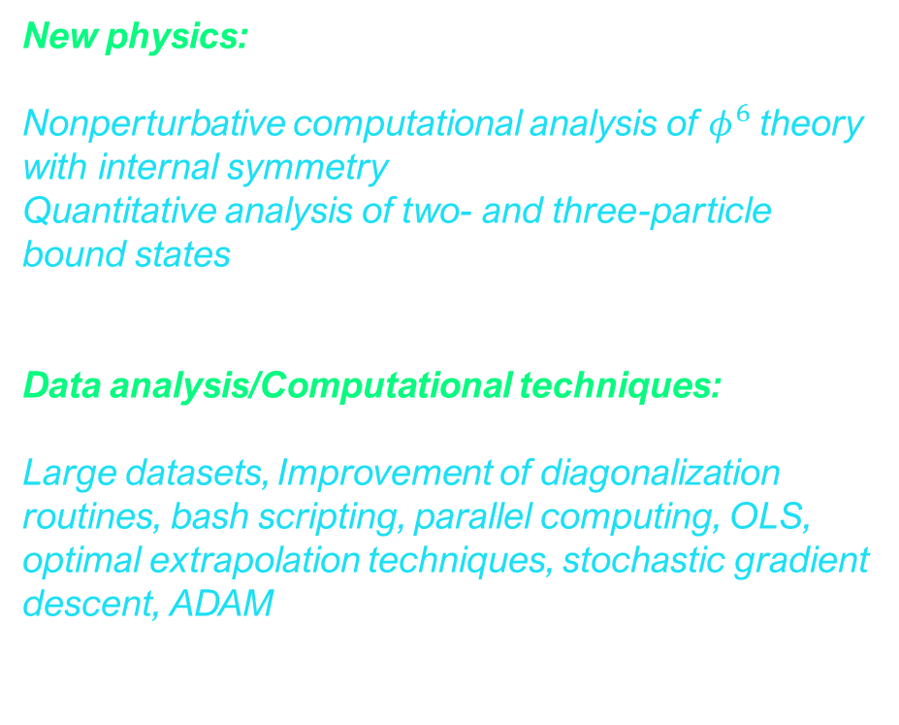

PROJECT II: $φ^{6}$ theory
New physics:
Nonperturbative computational analysis of $φ^{6}$ theory with internal symmetry
Quantitative analysis of two- and three-particle bound states
Data analysis/Computational techniques:
Large datasets, Improvement of diagonalization routines, bash scripting, parallel computing, OLS, optimal extrapolation techniques, stochastic gradient descent, ADAM

Slide 11
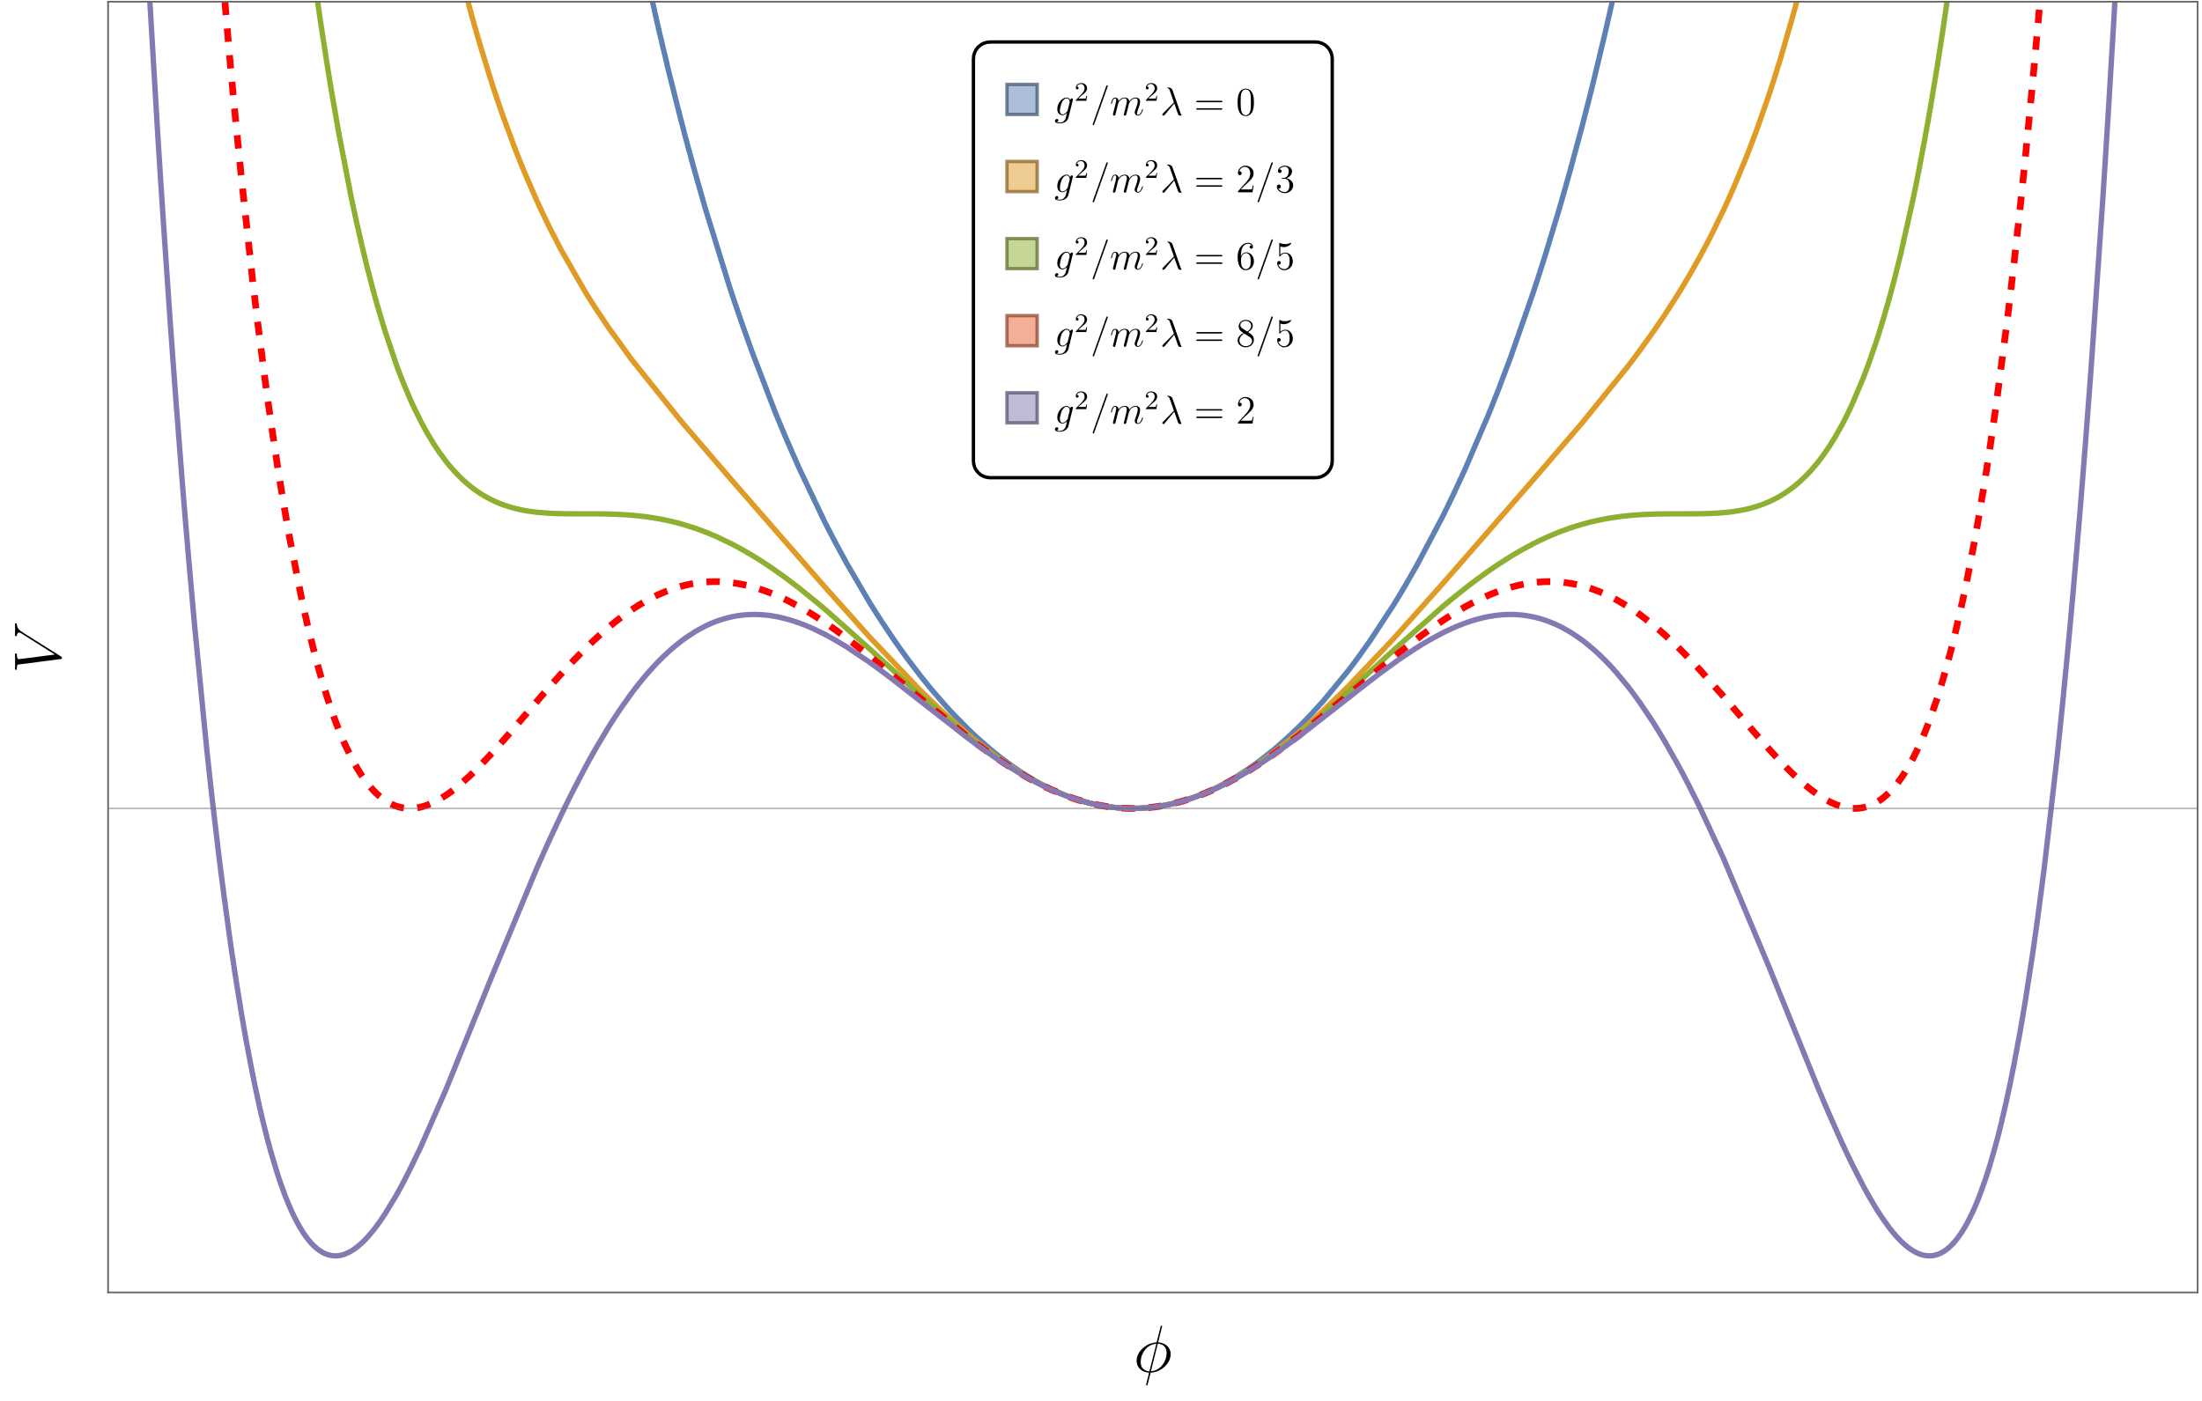
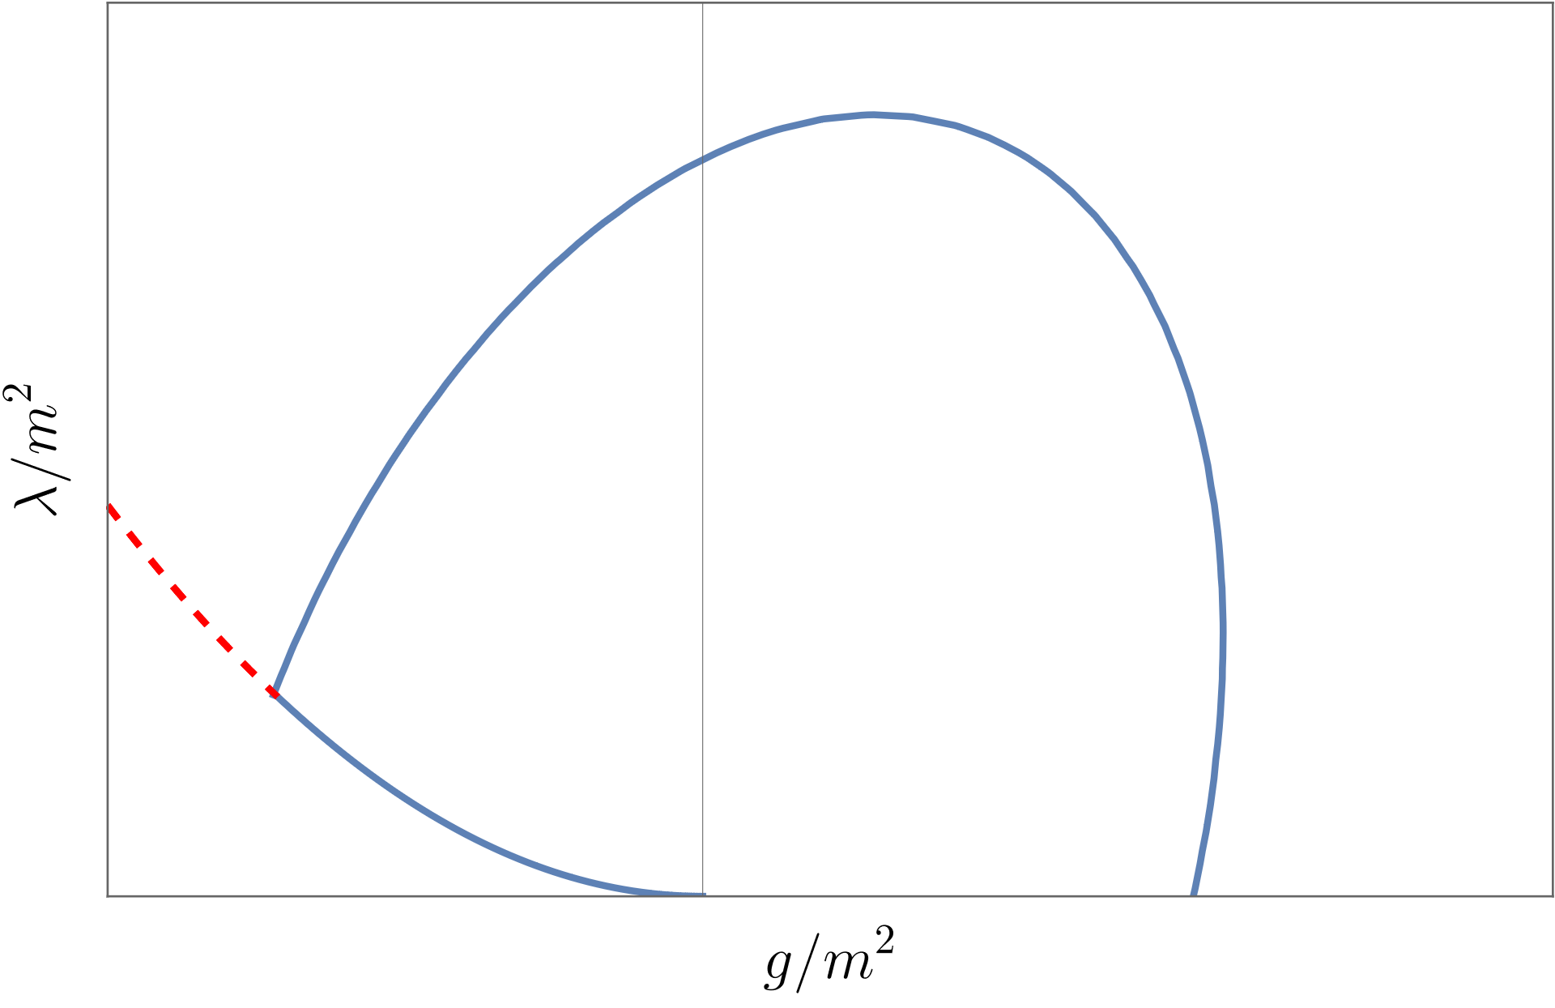
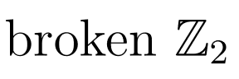
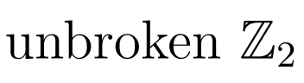
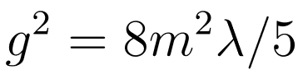

This target Hamiltonian presents with strong and weak spontaneous symmetry breaking
$$H_{LC}=\int{dx_{−}\left(\frac{λ}{6!}φ^{6}+\frac{g}{4!}φ^{4}+\frac{m^{2}}{2!}φ^{2}\right)}$$
Contains a strong coupling scaling critical point described by Tricritical Ising model.
Robust 2-particle and 3-particle bound states appear when $g<0$ due to attractive interactions.
Weak coupling shape of the transition curve:
$$g≈−\sqrt{\frac{8λm^{2}}{5}}$$
Expected semiclassical $Z_{2}$ breaking pattern for $H_{LC}$
Bound state?
Ising FP
Expected phase transition diagram and other features

Slide 12
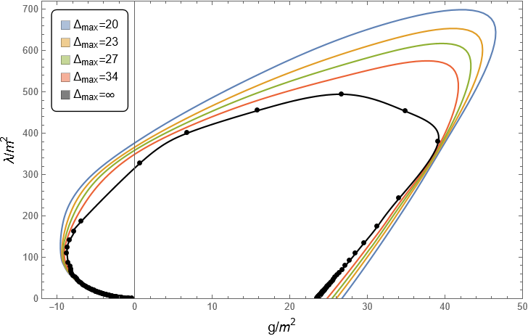
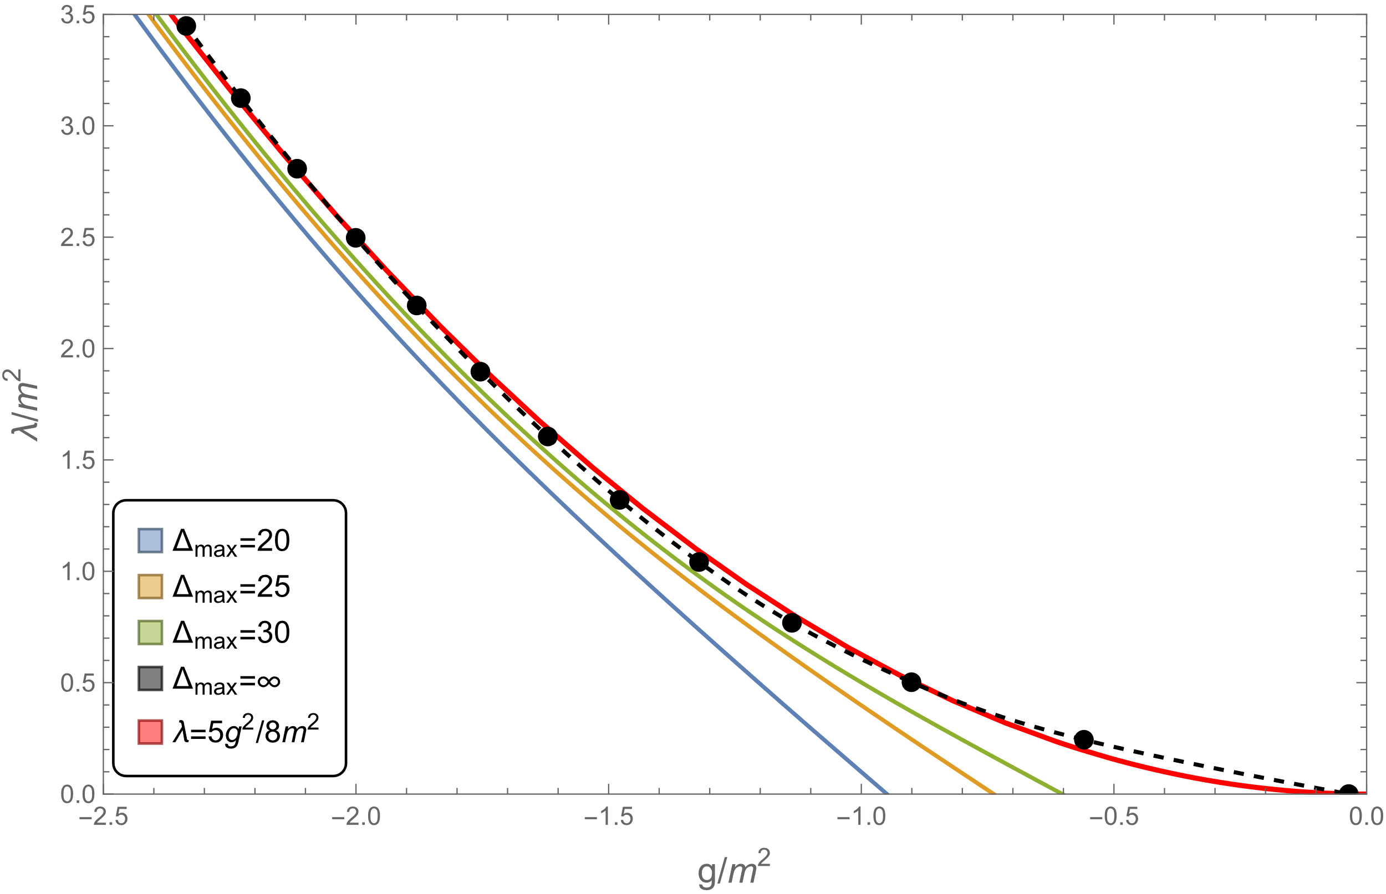
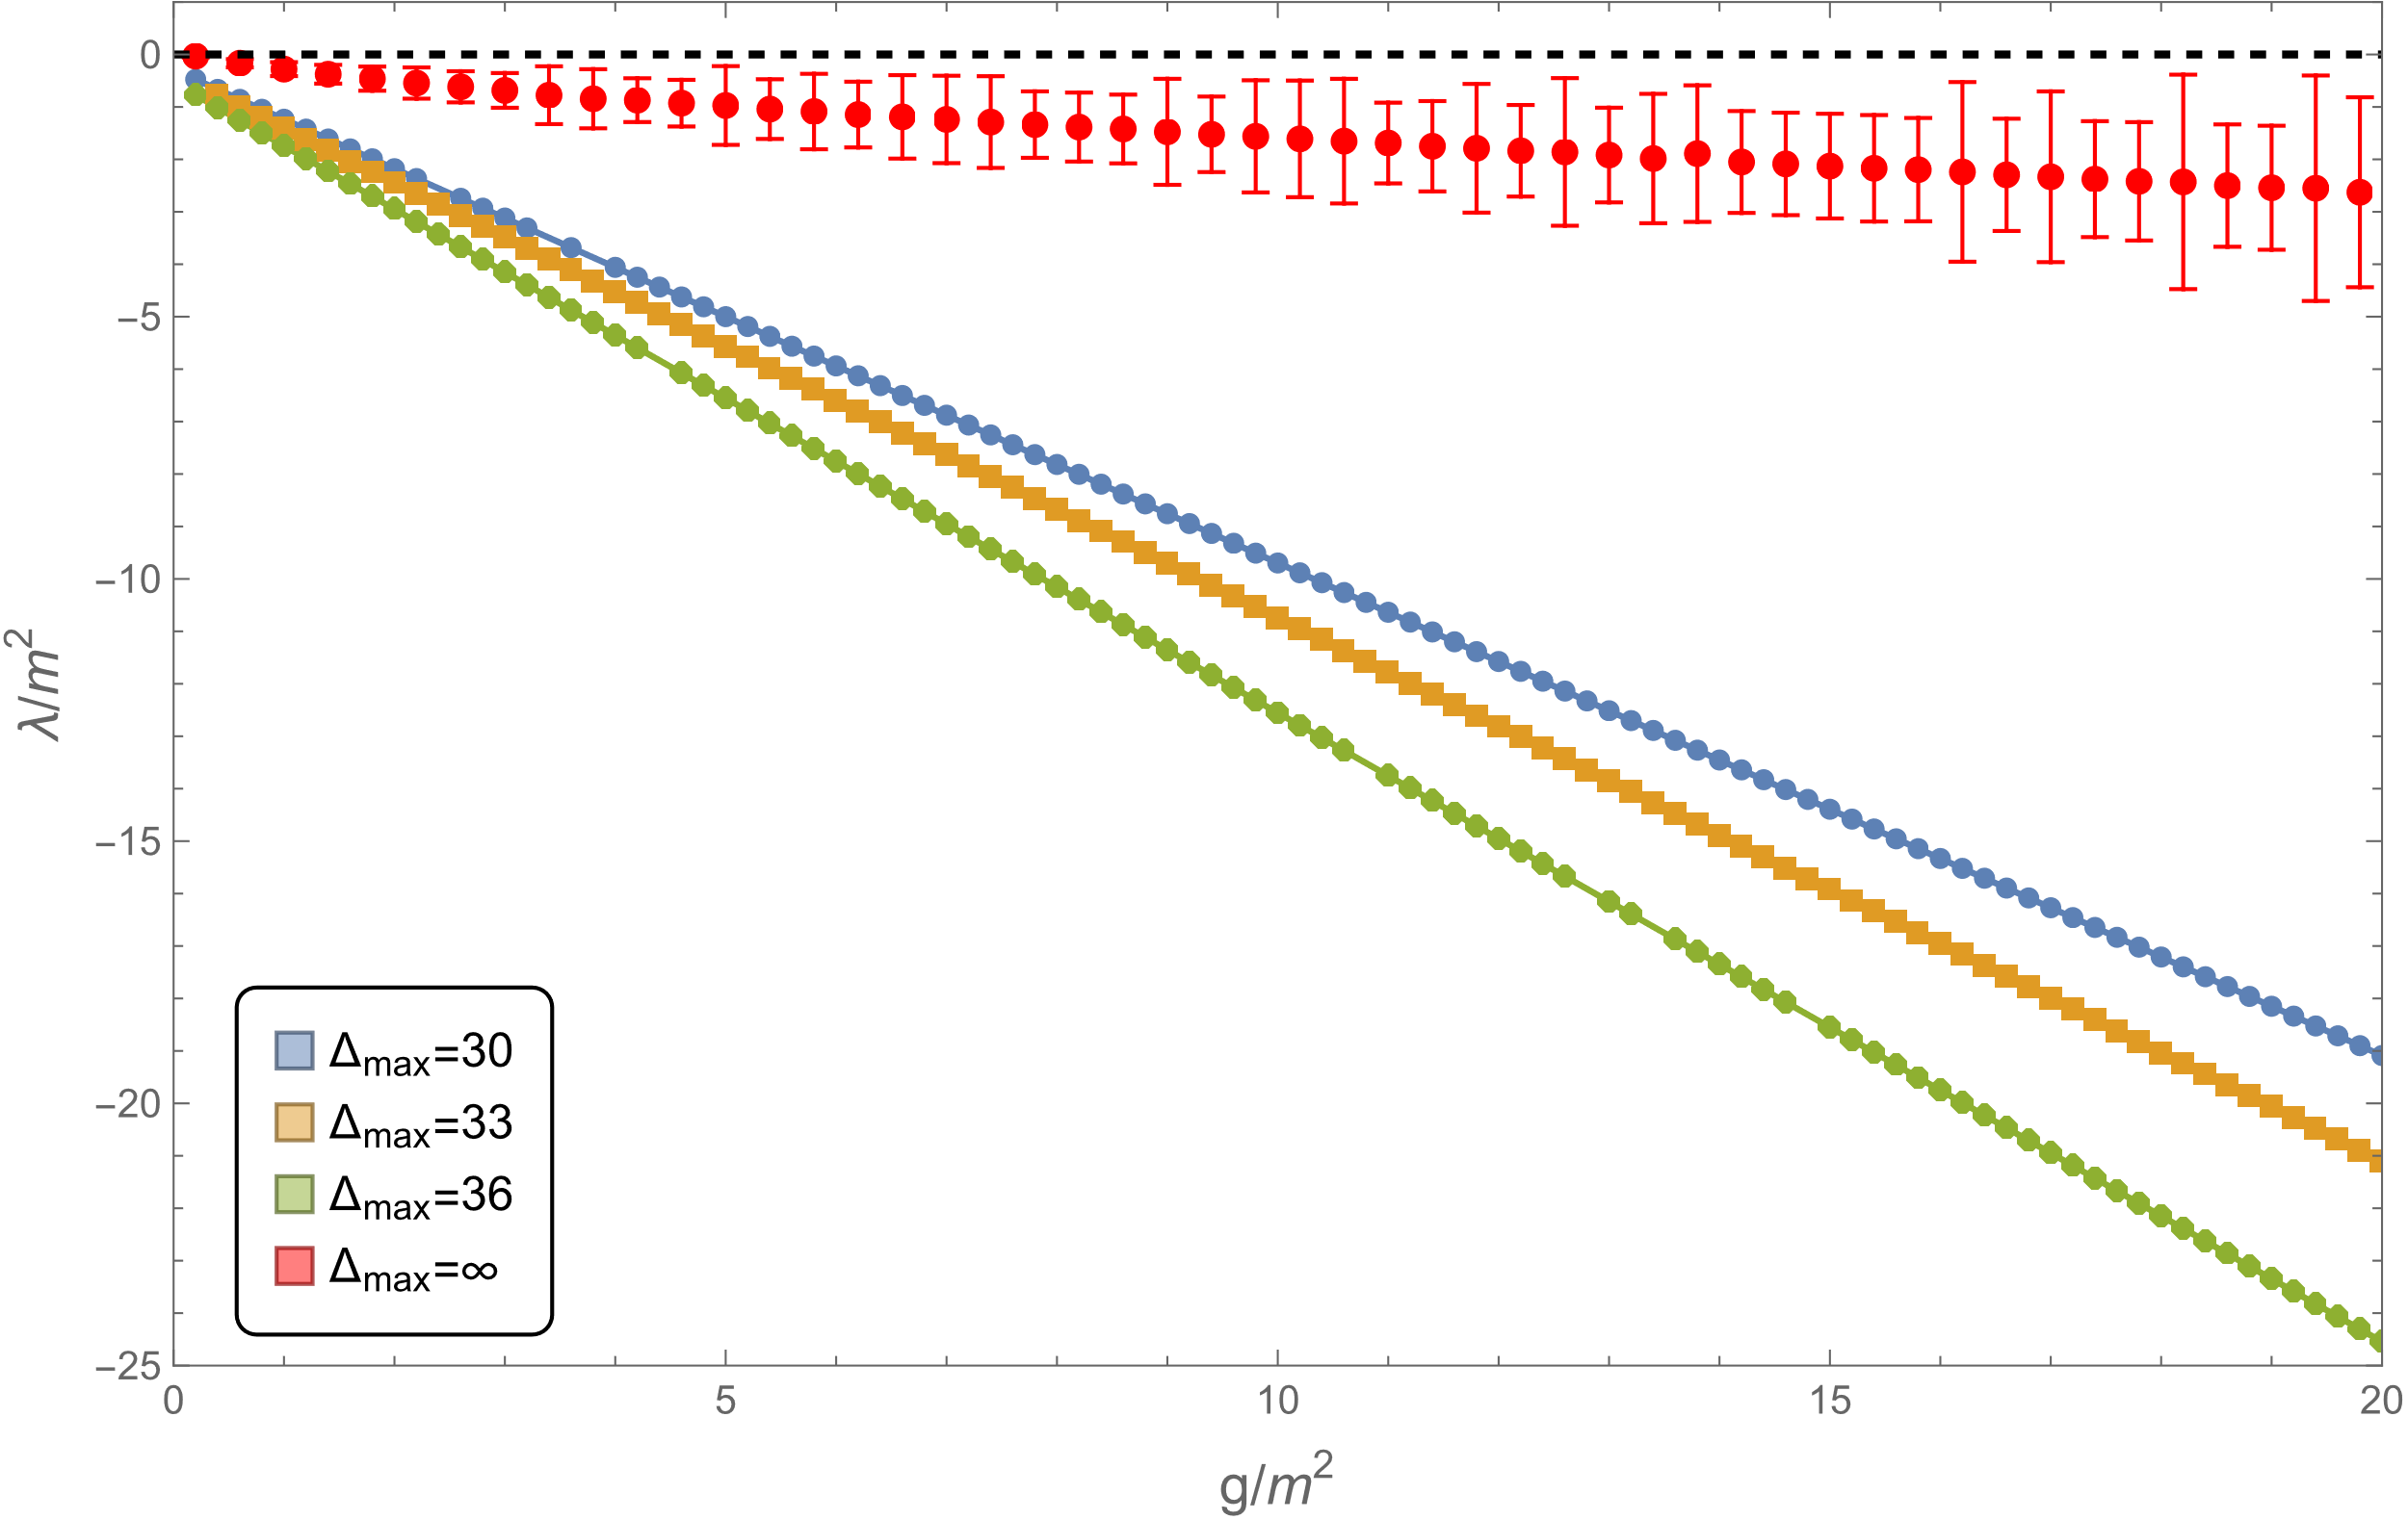
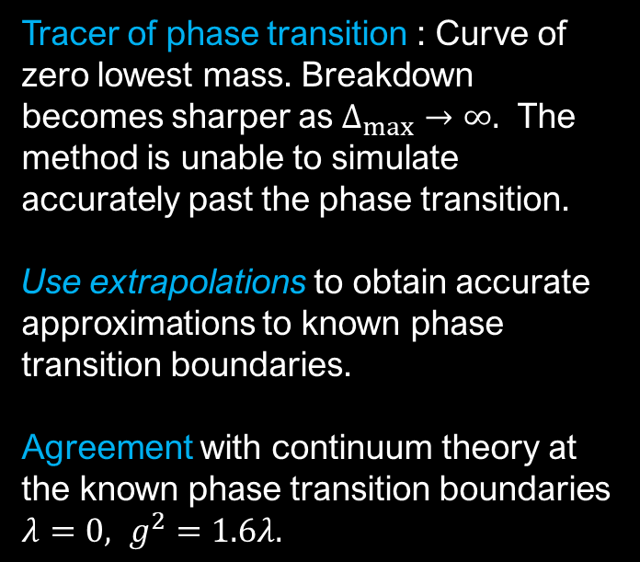
Tracer of phase transition : Curve of zero lowest mass. Breakdown becomes sharper as $Δ_{max}→∞.$ The method is unable to simulate accurately past the phase transition.
Use extrapolations to obtain accurate approximations to known phase transition boundaries.
Agreement with continuum theory at the known phase transition boundaries $λ=0, g^{2}=1.6λ.$
Phase transition prediction for various truncation levels. Continuum theory in black.
LCT simulations near phase boundaries $g^{2}=1.6λ$ (left), $λ=0$(right)

Slide 13
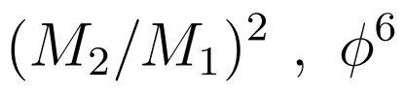
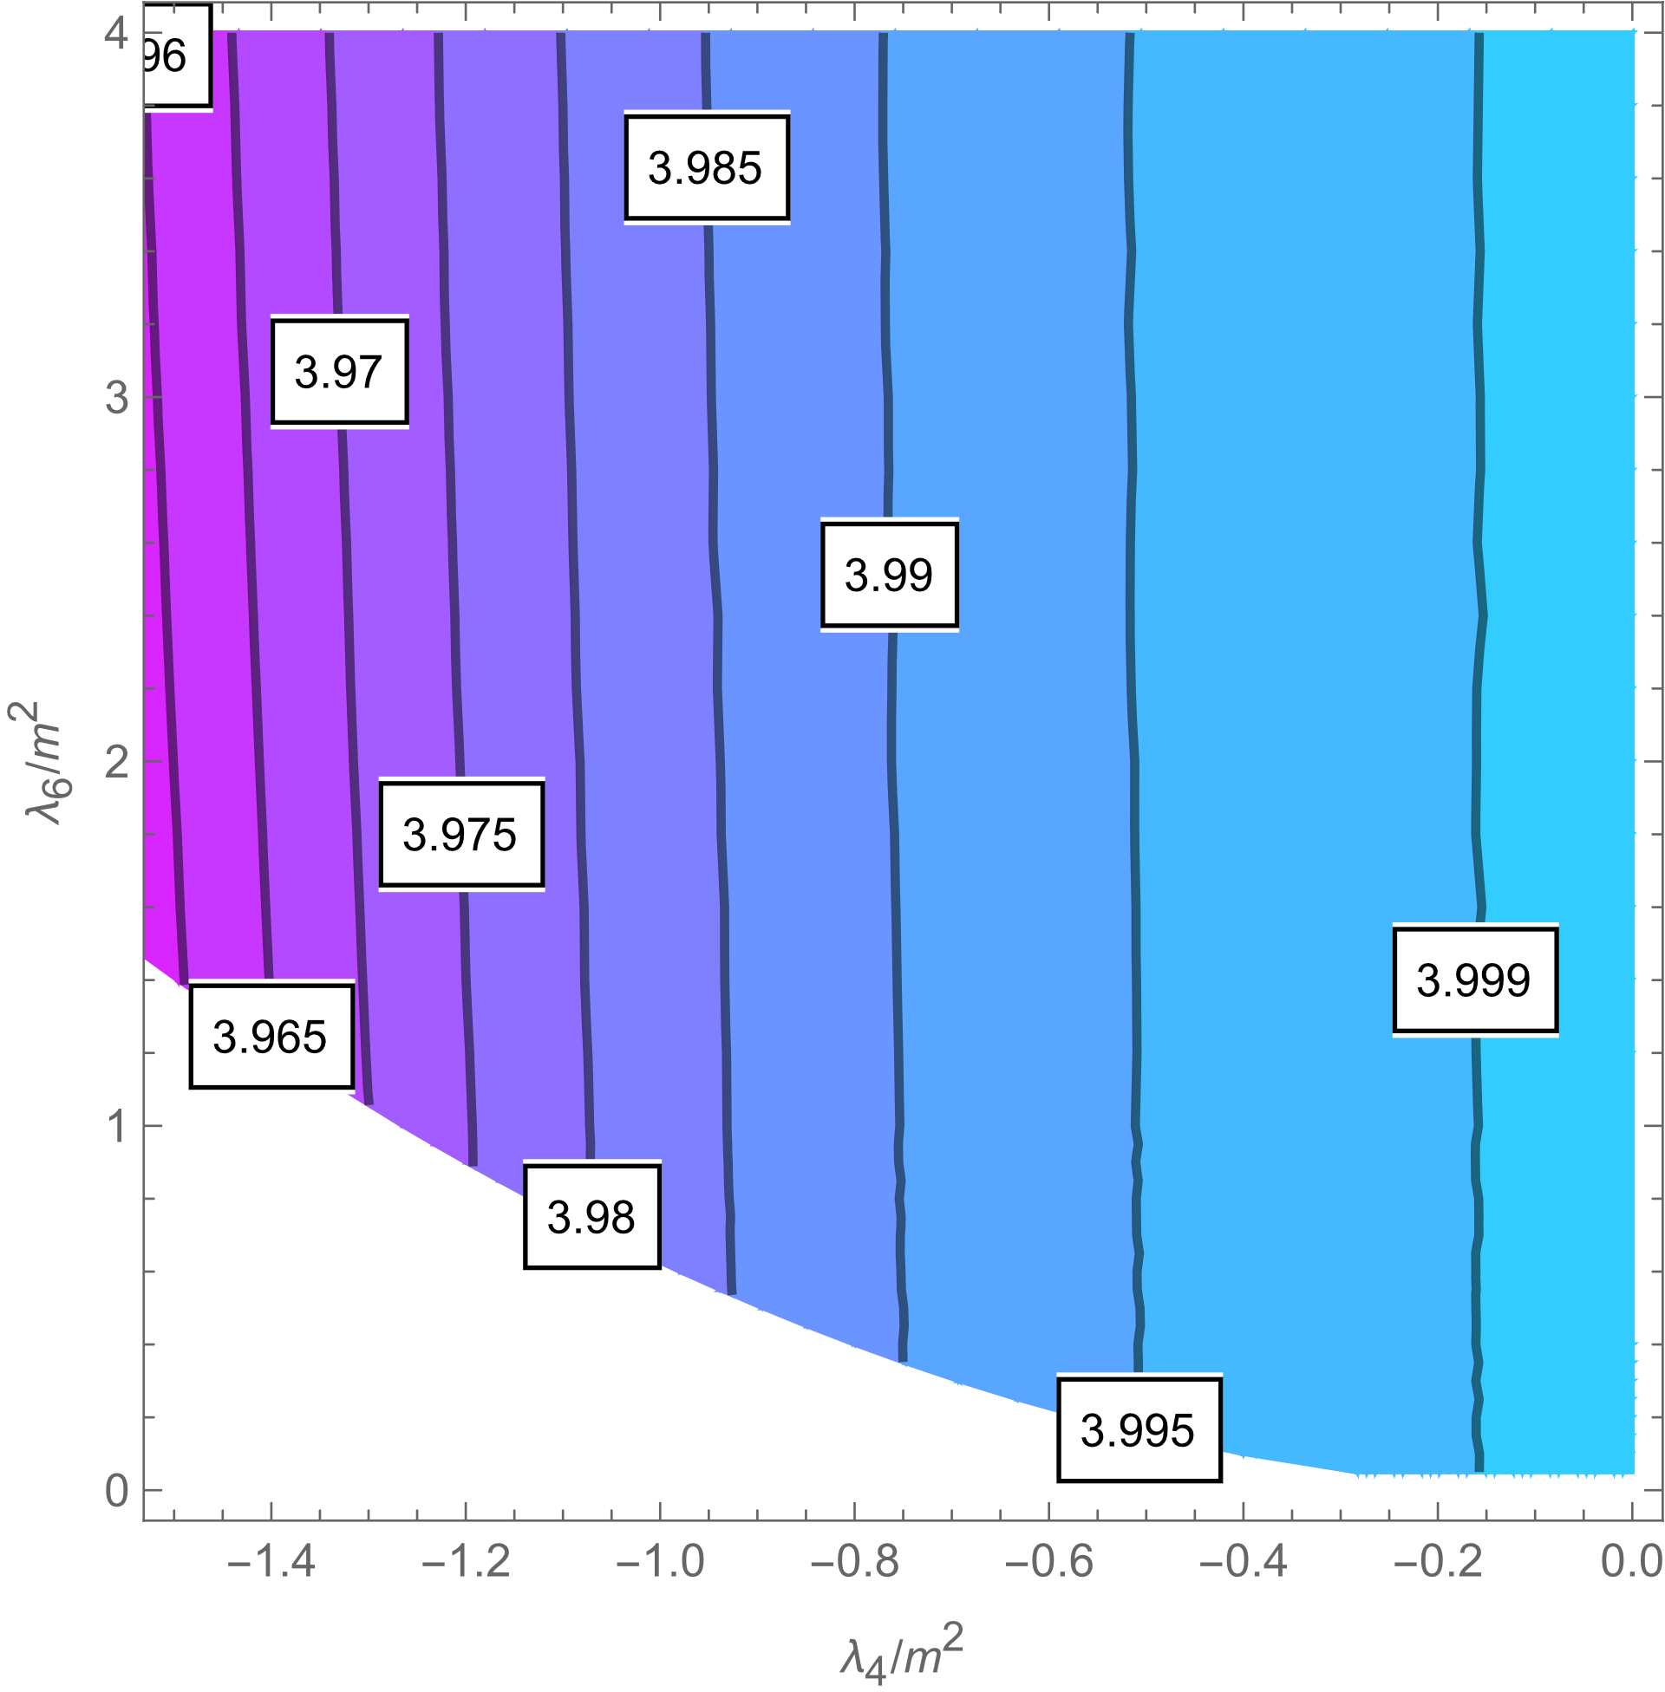
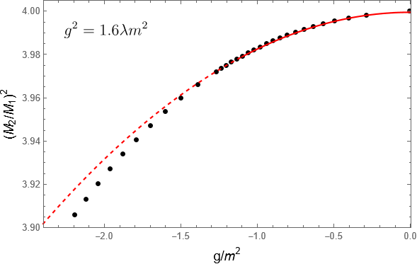
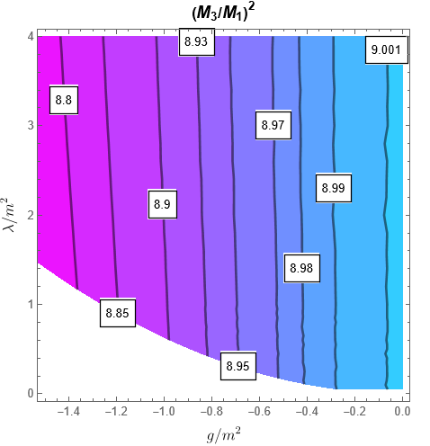
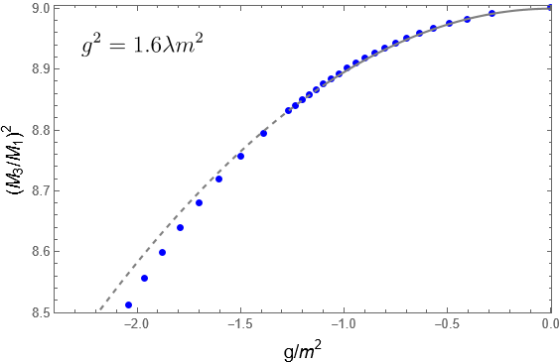


Threshold 2-particle bound state emerges due to attractive interactions, for $g<0$.
Simulation agrees with weak coupling prediction:
$$\frac{M_{2}^{2}}{M_{1}^{2}}=4−a_{2}\frac{g^{2}}{m^{4}}+…, a_{2}=\frac{1}{64}$$
2-particle bound state mass ratio off (left) and on (right) phase boundary
A threshold 3-particle bound state also exists in the theory and is easy to extract from simulations. Extrapolating and fitting suggests that at the phase boundary
$${\left(\frac{M_{3}}{M_{1}}\right)}^{2}=9−a_{3}{\left(\frac{g}{m^{2}}\right)}^{2}+…, a_{3}=0.036$$
twice as large as the two-particle state, suggesting a direction for a non-relativistic analysis (future work)
3-particle bound state mass ratio off (left) and on (right) phase boundary

Slide 14
PROJECT III: Variational LCT (In progress)
Features:
Analytical handle on nonperturbative physics
Complement / improve predictions of traditional LCT
Minimize computational time and extrapolations required
Analytical/Computational techniques:
Asymptotic analysis, approximating functions to arbitrary precision over entire range, analytic continuation, multi-parameter optimization, stochastic gradient descent, ADAM, simulated annealing

Slide 15

Issue:
LCT is essentially a black box variational ansatz; the Hilbert space of an appropriate UV theory is used to approximate the IR theory. Obtaining analytical results from the scheme is impractical.
The truncation scheme transforms problem into linear algebra of finite matrices; this point of view is unnecessarily restrictive theoretically - states can only be composed out of a finite number of particles. Phase transitions require participation of high particle sectors.
Resolution:
Sacrifice linearity of the problem by approximating the lowest energy eigenvectors using trial functions. Reorganize operator basis by quantum numbers $\left(J,n\right)=(Δ−n, n)$. For fixed low values of $J$, exact matrix element expressions can be obtained for arbitrary $n$, allowing us to write states that contain an arbitrarily high number of particles.
Pros: Can obtain similar or better results with a fraction of the computational effort, as long as asymptotics of lowest eigenvector are correct; can reproduce phase transitions much better (especially the trivial ones), with a very small number of variational parameters.
Cons: Higher eigenvalues non-trivial, bound state structure obscure; needs additional work to ensure variational energy is represented accurately for all values of the variational parameters.

Slide 16
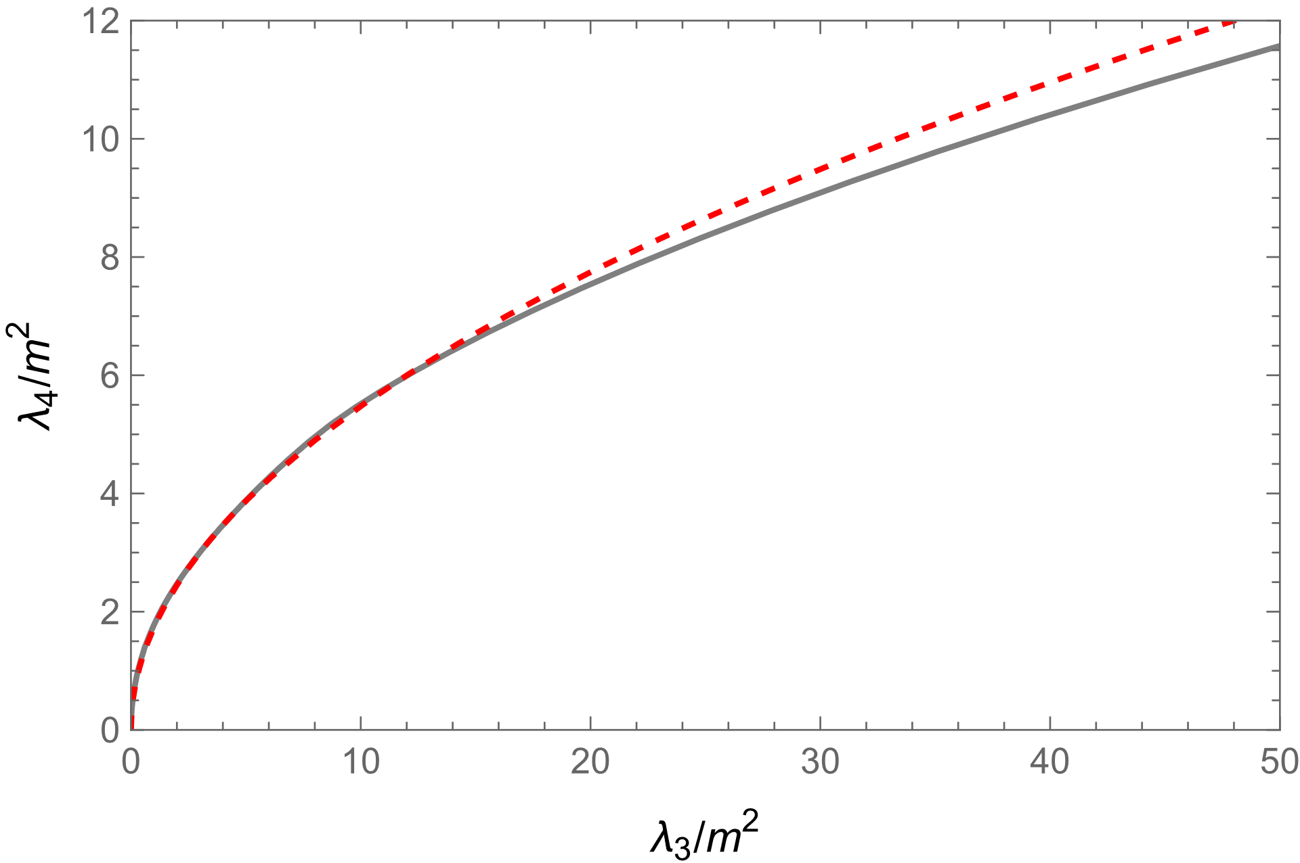
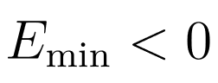
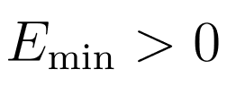
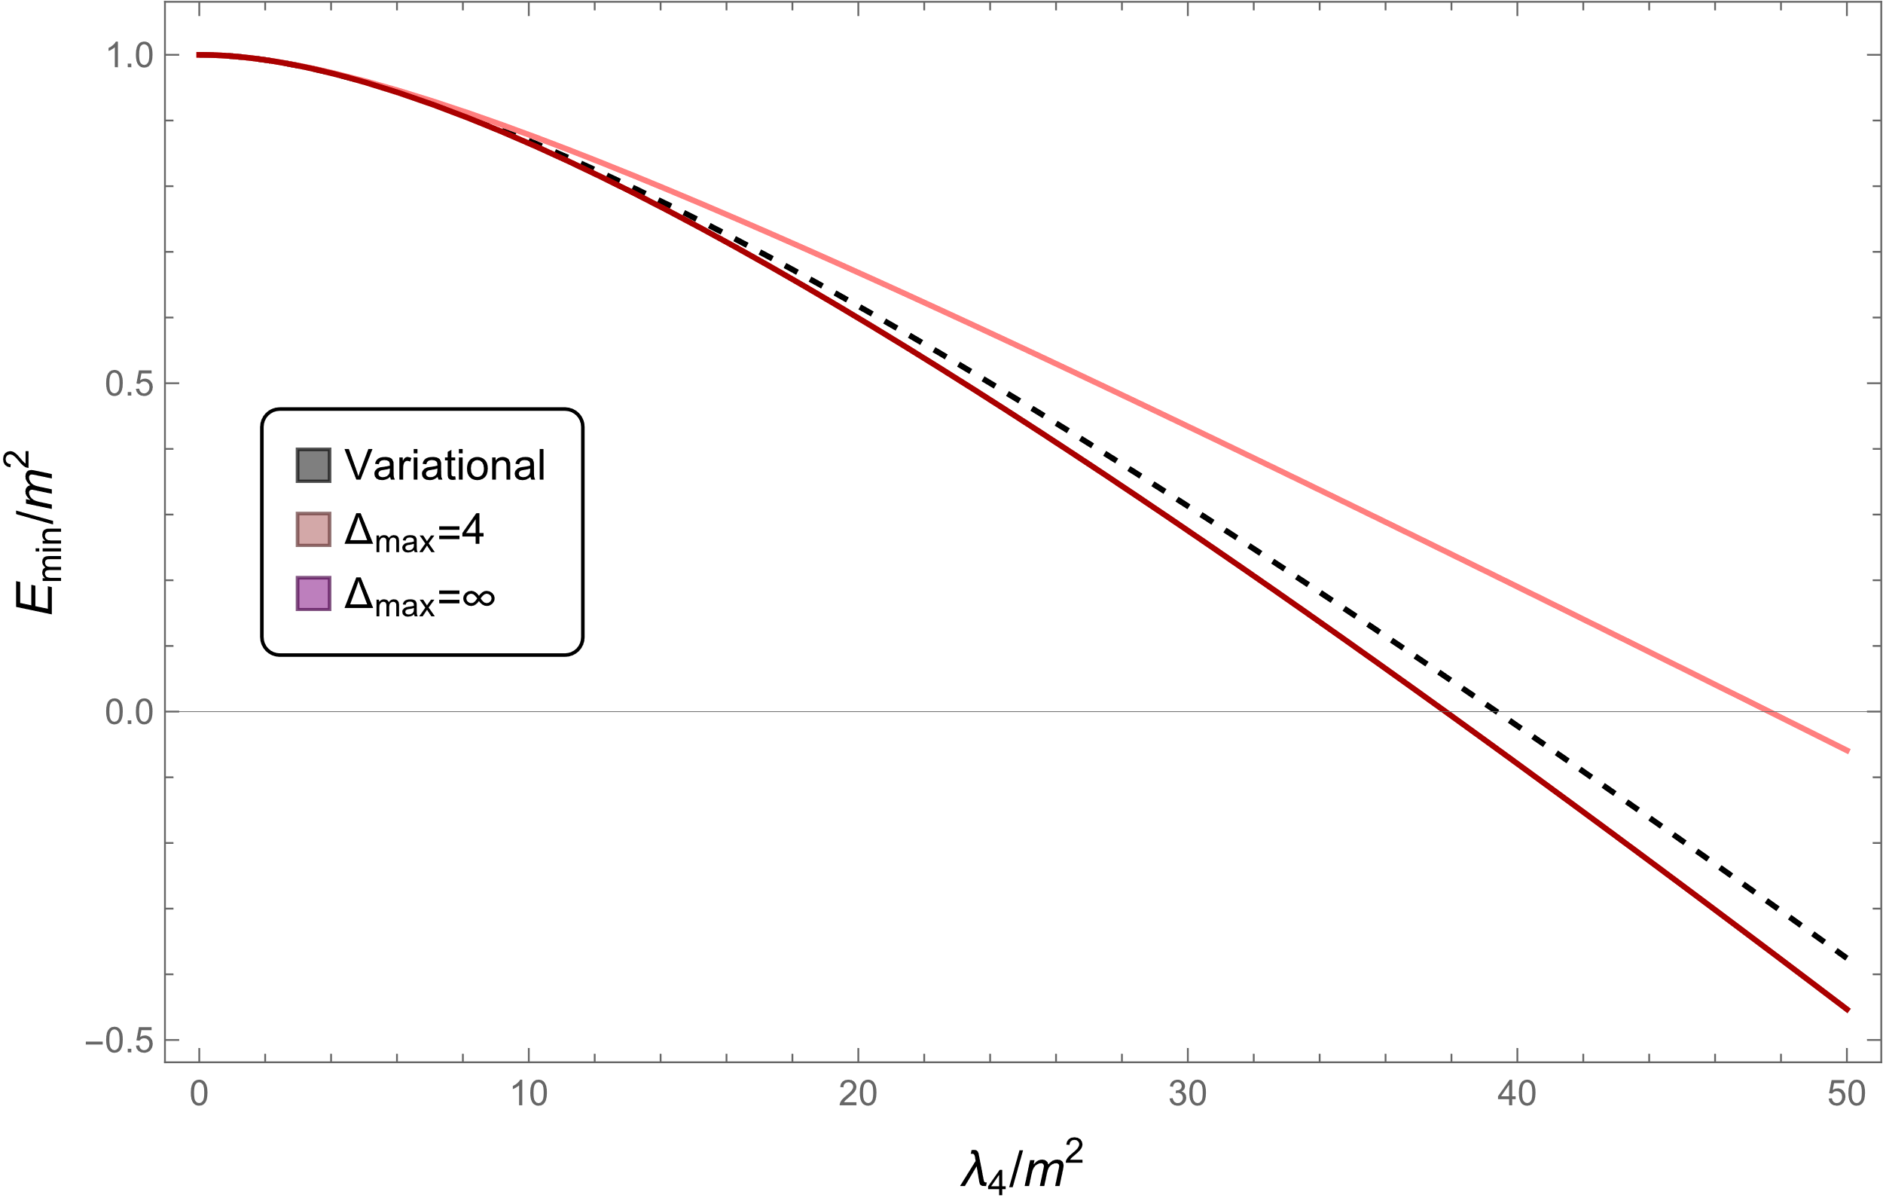
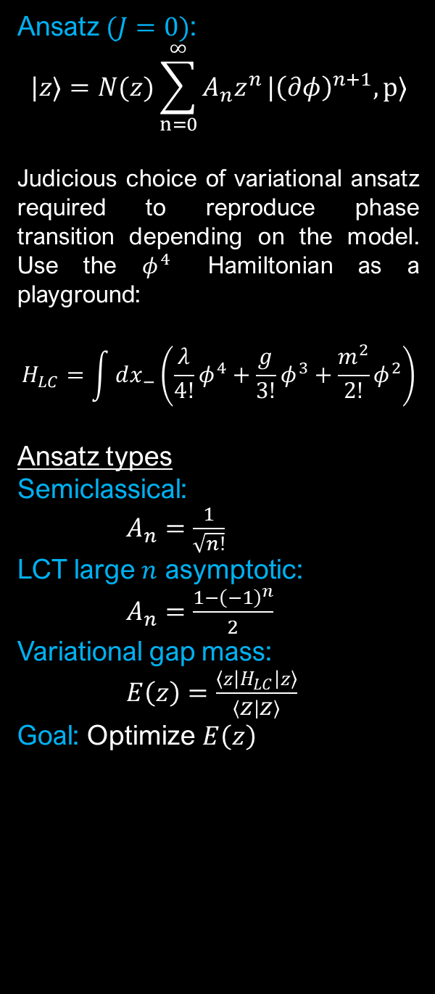
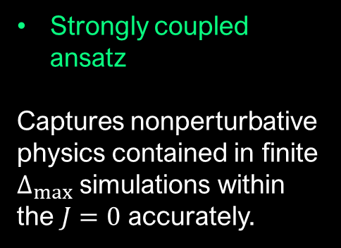
Ansatz $(J=0)$:
$$|z⟩=N(z)\sum_{n=0}^{∞}{A_{n}z^{n}}|{\left(∂φ\right)}^{n+1},p⟩$$
Judicious choice of variational ansatz required to reproduce phase transition depending on the model. Use the $φ^{4}$ Hamiltonian as a playground:
$$H_{LC}=\int{dx_{−}\left(\frac{λ}{4!}φ^{4}+\frac{g}{3!}φ^{3}+\frac{m^{2}}{2!}φ^{2}\right)}$$
Ansatz types
Semiclassical: $A_{n}=\frac{1}{\sqrt{n!}}$
LCT large $n$ asymptotic: $A_{n}=\frac{1−{\left(−1\right)}^{n}}{2}$
Variational gap mass: $E\left(z\right)=\frac{\left\langle z\left|H_{LC}\right|z\right\rangle }{\left\langle z | z\right\rangle }$
Goal: Optimize $E\left(z\right)$
Preliminary results
Semiclassical ansatz
Captures weak coupling transition perfectly, fails to capture strong coupling transition.
Strongly coupled ansatz
Captures nonperturbative physics contained in finite $Δ_{max}$ simulations within the $J=0$ accurately.

